Slide 1
Programming Fundamentals

Slide 2
Today’s Lecture
Whitespaces
Comments
CPU and Memory
Variable Types
Integer Variables

Slide 3
Whitespace
Compiler ignores whitespace almost completely.
Whitespace is defined as spaces, tabs and newlines.
These characters are invisible to the compiler.
You can put several statements on one line, separated by any number of spaces or tabs, or you can run a statement over two or more lines.

Slide 4
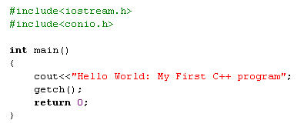
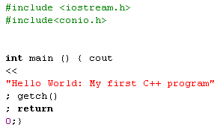
Two new lines

Slide 5
Exceptions to the rule
The first line of the program, starting with #include, is a preprocessor directive, which must be written on one line.
Also, string constants, such as “Every age has a language of its own”, cannot be broken into separate lines.
If you need a long string constant, you can insert a backslash(\) at the line break or divide the string into two separate strings, each surrounded by quotes.

Slide 6
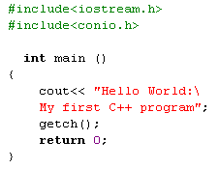
Example
Backslash

Slide 7
Comments
They help the person writing a program, and anyone else who must read the source file, understand what’s going on.
The compiler ignores comments

Slide 8

Comment Syntax
Comments start with a double slash symbol (//) and terminate at the end of the line.

Slide 9

Alternative Comment Syntax

Slide 10

Comments
If you attempt to use the // style comment in this case, the closing brace won’t be visible to
the compiler-- since a // style comment runs to the end of the line—and the code won’t compile correctly.

Slide 11
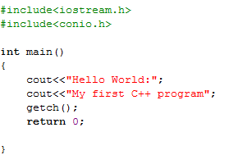
Outputs ??

Slide 12
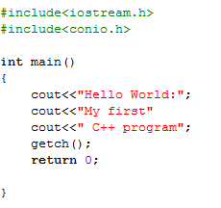
Outputs ??

Slide 13
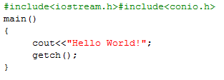
Outputs ??

Slide 14
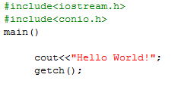
Outputs ??

Slide 15
CPU and Memory
A computer acts on data according to the instructions specified in a program (like our previous C++ program) and produces the output.
This computation is done by Central Processing Unit(CPU) of the computer.
A CPU of computer performs arithmetic operations such as addition, subtraction, multiplication and division and also performs logical operation on the data such as comparing two numbers.

Slide 16
CPU and Memory
Memory of a computer is the area where data and programs are stored.
A computer memory is made up of cells that is capable of holding information in the form of binary digits 0 and 1 (bits).
This is the way information is stored in a memory just like we memorize numbers using 0 to 9.

Slide 17
CPU and Memory
Collection of 8 bits is called a byte.
Normally the CPU does not accessed memory by individual bits.
Instead, it accesses data in a collection of bits, typically 8 bits, 16 bit, 32 bit or 64 bit.
The amount if bits on which it can operate simultaneously is known as the word length of the computer.

Slide 18
CPU and Memory
When we say that Pentium 4 is a 32 bit machine, it means that it simultaneously operates on 32 bit of data.

Slide 19
Program memory
When the program is compiled and linked, different parts of the program is organized in separate segments.
Our code will be in one segment.
Code means the instructions to be executed
That segment is called as code segment or program memory.
Notes:
http://www.cs.uwm.edu/classes/cs315/Bacon/Lecture/HTML/ch10s04.html

Slide 20
Data segment and Stack memory
Then there is data on which the code operates, this data get stored in a segment called Data segment.
Stack memory is a part of programs memory which will be used in case of function calls

Slide 21
Program Memory
The three types of memory specified above are owned by the corresponding process or program.
The linker will give information about where to store which data to the loader
Based on these information loader will load the corresponding executable(.exe in our case)in the memory.

Slide 22
Heap memory
Heap memory is the memory which is owned by the process when a process requests for extra memory.
These requests are done by the malloc and calloc function calls.

Slide 23
Program vs Process
A program needs memory when it gets executed and a program under execution is a process.

Slide 24
CPU and Memory
Data is stored in the memory at physical memory locations.
These locations are known as the memory address.
It is very difficult for humans to remember the memory addresses in numbers like 46735, so instead we name a memory address by a variable.

Slide 25
Simplistic View of a Computer
Each location is
1 byte of memory
1 byte = 8 bits
Each bit is carrying 1 or 0.

Slide 26
Variable
To store a value inside a computer a ‘variable’ is used.
A variable is a space in the memory to store a value.
This space is reserved until the variable is required.

Slide 27
What Makes a Variable
Variable has three important characteristics:
Type
How much memory do a variable need.
This information is determined by a type.
Name
How to differentiate a variable with another variable of the same type.
Name refers to the memory location assigned to this variable.
Value
What is the value?
The actual value contained by a variable.

Slide 28
An Example of a Variable
Type of the variable is integer (written as “int” in C++)
int
temperature
35
=
A name of the variable
An initial value of the variable

Slide 29
Example of a Variable (Memory View)
int temperature =35
00000000
Location 0
Locations 0 – 3 are collectively
called as ‘temperature’
00000000
Location 1
00000000
Location 2
00100011
Location 3
Location 4
100011 is the binary equivalent of 35
Location 5

Slide 30
Changing the Value of Variable
Lets change the value of ‘temperature’.
temperature = 45902
00000000
Location 0
Locations 0 – 3 are collectively
called as ‘temperature’
00000000
Location 1
Location 2
10110011
Location 2
01001110
Location 3
Location 4
1011001101001110 is the binary equivalent of 45902
Location 5

Slide 31
Variable types
Most popular languages use the same general variable types, such as integers, floating-point numbers, and characters

Slide 32
Integer variables
Integer variables represent integer numbers like 1, 30,000, and –27.
Such numbers are used for counting discrete numbers of objects, like 11 pencils or 99 bottles of beer.
Unlike floating point numbers, integers have no fractional part; you can express the idea of four using integers, but not four and one-half.

Slide 33
Contdd . . . .
The amount of memory occupied by the integer types is system dependent.
On a 32-bit system such as Windows, an int occupies 4 bytes (which is 32 bits) of memory.
This allows an int to hold numbers in the range from –2,147,483,648 to 2,147,483,647.

Slide 34

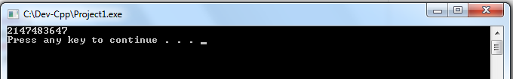
Example
OUTPUT

Slide 35

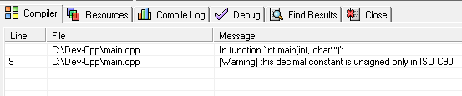
Example
Compile time error

Slide 36
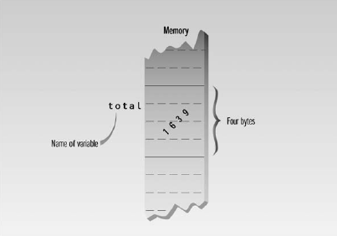
Defining Integer Variables

Slide 37
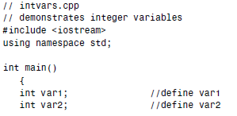
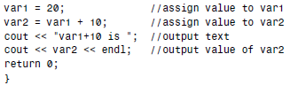
Here’s a program that defines and uses several variables of type int:

Slide 38
Explanation
The statements
int var1;
int var2;
declare two integer variables, var1 and var2
The keyword int signals the type of variable.
These statements, which are called declarations, must terminate with a semicolon, like other program statements.

Slide 39
Contdd . . . .
You must declare a variable before using it.
However, you can place variable declarations anywhere in a program.

Slide 40
Declarations and Definitions
A declaration introduces a variable’s name (such as var1) into a program and specifies its type (such as int).
However, if a declaration also sets aside memory for the variable, it is also called a definition.

Slide 41
Variable Names
The names given to variables (and other program features) are called identifiers.
What are the rules for writing identifiers?
You can use upper- and lowercase letters, and the digits from 1 to 9.
You can also use the underscore (_).
The first character must be a letter or underscore.

Slide 42

Contdd . . . .
Identifiers can be as long as you like, but most compilers will only recognize the first few hundred characters.
The compiler distinguishes between upper- and lowercase letters, so Var is not the same as var or VAR.
You can’t use a C++ keyword as a variable name.

Slide 43
Keyword
A keyword is a predefined word with a special meaning.
int, class, if, and while are examples of keywords.

Slide 44
Example program

Slide 45

Assignment Statements
The statements
assign values to the two variables.
The equal sign (=) causes the value on the right to be assigned to the variable on the left.

Slide 46
Integer Constants
The number 20 is an integer constant.
Constants don’t change during the course of the program.
An integer constant consists of numerical digits.
There must be no decimal point in an integer constant, and it must lie within the range of integers.

Slide 47
Example program

Slide 48
Output Variations
The statement
displays a string constant. The next statement
displays the value of the variable var2.
OUTPUT???

Slide 49
The endl Manipulator
This causes a linefeed to be inserted into the stream, so that subsequent text is displayed on the next line.
It has the same effect as sending the ‘\n’ character.
Its an example of a manipulator.

Slide 50
Manipulators
Manipulators are instructions to the output stream that modify the output in various ways; we’ll see more of them as we go along.

Slide 51
Class Participation
Which of the following is a correct comment? A. */ Comments */ B. ** Comment ** C. /* Comment */ D. { Comment }

Slide 52
Class Participation
Which of the following is the correct assignment operator ?
A. := B. = C. equal D. ==

Slide 53
Questions???

